Slide 1



Clinical Data Management Process
Presented by- Akshata chandak
Aarti yadgire
Dr. Geetu mohan
Manasi dhamal

Slide 2

Contents
Introduction
Need
Key members
Responsibilities of CDM
CDM Process overview
www.siroinstitute.com

Slide 3
Clinical Data Management
Clinical data management is critical process in clinical research which leads to generation of high-quality, reliable, and statistically sound data from clinical trails.
Clinical data management ensures collection, integration and availability of data at appropriate quality and cost .
www.siroinstitute.com

Slide 4
Need
Review & approval of new drugs by Regulatory Agencies is dependent upon a trust that clinical trials data presented are of sufficient integrity to ensure confidence in results & conclusions presented by pharma company
Important to obtaining that trust is adherence to quality standards & practices
Hence companies must assure that all staff involved in the clinical research are trained & qualified to perform data management tasks
www.siroinstitute.com

Slide 5
Key Members
Project
Manager
Clinical Data
Manager
Medical
Coder
Key Members
Data Entry Operator
Data Administrator
Clinical Data Associate
Database Programmer
Clinical Data Coordinator
www.siroinstitute.com

Slide 6

Responsibilities Of CDM
Study Setup
CRF design and development (paper/e-CRF)
Database build and testing
Edit Checks preparation and testing
Study Conduct
Data Entry
Discrepancy Management
Data Coding (using MedDRA and WHODDE dictionaries)
Data review (Ongoing QC)
SAE Reconciliation Data Transfer
Study Closeout
SAE Reconciliation
Quality Control
Database Lock
Electronic Archival
Database Transfer
www.siroinstitute.com

Slide 7
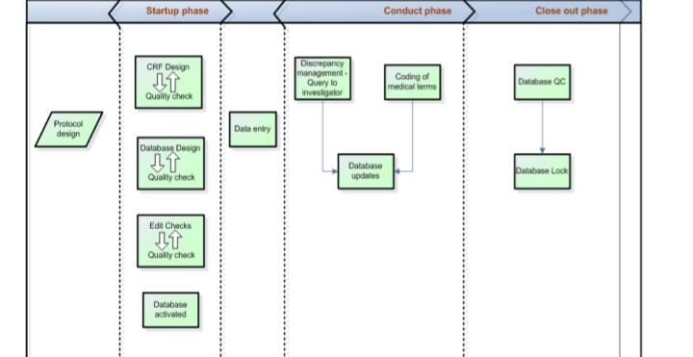
CDM Process Overview
www.siroinstitute.com

Slide 8

Study Startup Process
CRF Design
Protocol
Database
Design
Validation/ Derivation Procedures
Activated Database Ready To Accept Production Data
www.siroinstitute.com

Slide 9

CRF Design
A representation of the study as outlined in the protocol is made. Therefore a final protocol needs to be available before CRF design.
There are two types of CRF
1)Paper CRF
2) ECRF
It takes about three rounds in CRF design:-
First draft (rough without detail but correct content)
Second draft (as good as we can get it)
Final version
Database Design
Data from a clinical trial will be collected and stored in the CDMS a database is simply a structured set of data
A collection of rows and columns
Database management systems used are:-
MS Access, MS Excel, Oracle Clinical, Clintrial, Phaseforward InForm, medidata review
www.siroinstitute.com

Slide 10

Validation Procedure
Edit specifications list describes in detail which data shall be checked and queried if necessary.
The programming of the checks according to edit specification list, before programming starts , the sponsor will be asked to give approval to this list
Test subjects are entered in the database to test the entry screens and the programming
Database Set Up and testing
Database setup and testing are always performed in a secure, non study data environment
Only when a database has been reviewed and fully tested , will it be set in production
Changes in structure or programming will always first be performed and tested in the non study data environment before they are made effective in production database
www.siroinstitute.com

Slide 11

Study conduct process
Activated DB
Data entry/data loading (CRF and external data)
Discrepancy Management
Safety Data Reconcilation
Coding Terms
Query generation
Resolution &/or update of database
Manual checks/QC
www.siroinstitute.com

Slide 12
CRF Tracking
Logistic way if it is paper base study
EDC- electronic data capture if it is e-CRF data entry
Data Entry
Data entry is a process of entering/transferring data from case report form to the Clinical Data Management Systems (CDMS)
Data Entry:- 1) Single data entry
2) Double data entry
Discrepancy Management
Discrepancy management is a process of cleaning subject data in CDMS
It includes manual checks and programme checks
Trivial discrepancies are closed as per self evident correction method or Internal rulings and discrepancies which require response from the site are queried by raising DCF
www.siroinstitute.com

Slide 13
Medical coding
The medical coding for a study is done as per the project specific protocol requirement.
The dictionaries used for a study are:-
MedDRA
WHODD
SAE Reconciliation
Serious Adverse Event (SAE) data reconciliation is the comparison of key safety data variables between Clinical Data Management System(CDMS) and sponsor PV.
Reconciliation is performed to ensure that events residing in both systems are consistent
www.siroinstitute.com

Slide 14
Study Closeout Process
Quality Review
Database Lock
Data Transfer
Archival Activities
www.siroinstitute.com

Slide 15
Quality Review
Quality should be maintained for overall study by performing quality checks at intervals for all data points prior to database lock
Quality control helps to ensure that all data processed is accurate , clean and correct
Database lock
It is done after confirmation for the completion of all the data management activities
Approval for locking is obtained from all stakeholders and the database is locked
No modification in the database is possible after database lock
In case of critical issue only privileged users can modify the data
This require proper documentation and an audit with enough justification for updating the locked database
www.siroinstitute.com

Slide 16
Data Transfer
After database is locked the clean data is extracted and transferred for statistical analysis
Archival Activities
This involves preparing archival versions of Ecrf For the sites and the sponsors files
It is done for secure retention, maintenance and retrieval of data which goes to the Trial Master File
www.siroinstitute.com

Slide 17
References
https://www.altexs
oft.com/blog/clinical-data-management/
www.siroinstitute.com

Slide 18

www.siroinstitute.com

